Slide 1
More on Joins
Data Manipulation Language

Slide 2
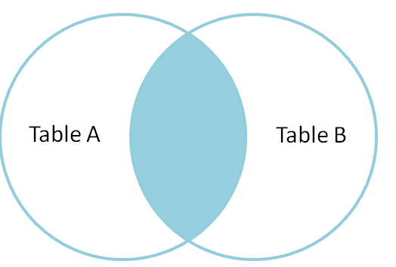
Inner Join – Two tables
Return the set of rows with data values that match in both Table A and Table B
Depends on select statement
Matching
Rows

Slide 3
Inner Join – Two tables
Matching
Rows
Can be natural, equi or non-equi join.
Difference is the columns you use to join and conditions you place on the join.
Equi joins depend on referential integrity (even if columns named differently) and equality
Non-Equi joins don’t need either referential integrity or equality.

Slide 4
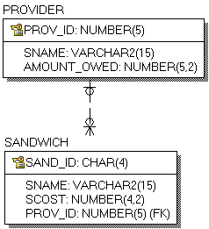
Small Sandwich Retailer
Sell Sandwiches to Customers (name, cost, the ID of the company that sells them to us)
For each provider we have the ID, the name and the amount we owe them.
SQL is available in L4-SandwichProvider.sql in Webcourses

Slide 5
Small Sandwich Retailer
What data should be returned by joining the two tables?
Sandwich Table Contents
SAND_ID | SNAME | SCOST | PROV_ID
BLTW | BLT on White | €3.50 | 23
BLTB | BLT on Brown | €3.50 | 23
JMBO | Jumbo Sandwich | €6.50 | 42
Suppose we want to execute a query with join these two tables?
What different types of join can we do?

Slide 6
Cartesian Product or Cross Join
SELECT * FROM PROVIDER, SANDWICH;

Slide 7
Cartesian Product or Cross Join
SELECT * FROM PROVIDER, SANDWICH;
Every single row in sandwich will be paired with every single row in provided regardless of whether the provider ID matches
Output is a set of ordered pairs

Slide 8
Cartesian Product or Cross Join
SELECT * FROM PROVIDER CROSS JOIN SANDWICH;
Every single row in sandwich will be paired with every single row in provided regardless of whether the provider ID matches
PRODUCT
Set of ordered pairs

Slide 9
Natural Join
“NATURAL” means equi-join for each pair of attributes with the same name and datatype
Will match on all columns which have the same name and datatype which have the same value in both tables
Which columns are going to be considered?
Remember what you get back depends on the data values
Select * from sandwich natural join provider;

Slide 10
Natural Join
The natural join tried to join on prov_id and sname
There are no rows that have the same entry in both columns i.e. no row in sandwich that has prov_id and sname matching a row in provider that has same values for these columns.
Select * from sandwich natural join provider;
Result
No matches found!
Sandwich Table Contents
SAND_ID | SNAME | SCOST | PROV_ID
BLTW | BLT on White | €3.50 | 23
BLTB | BLT on Brown | €3.50 | 23
JMBO | Jumbo Sandwich | €6.50 | 42

Slide 11
Natural Join
The natural join tried to join on prov_id and sname
There are no rows that have the same entry in both columns i.e. no row in sandwich that has prov_id and sname matching a row in provider that has same values for these columns.
Select * from sandwich natural join provider;
No matches found!
Why Not?
Yes there is a match on SNAME but for that row the value of PROV_ID is different (42 does not match with 22)
Sandwich Table Contents
SAND_ID | SNAME | SCOST | PROV_ID
BLTW | BLT on White | €3.50 | 23
BLTB | BLT on Brown | €3.50 | 23
JMBO | Jumbo Sandwich | €6.50 | 42

Slide 12
Join USING (Inner Join, Equi Join)
Columns have same name and datatype in both tables
Select *
from sandwich
join provider using (prov_id);
PROV_ID | SAND_ID | SNAME | SCOST | SNAME_1 | AMOUNT _OWED
23 | BLTW | BLT on White | €3.50 | O'Brien's | €540.00
23 | BLTB | BLT on Brown | €3.50 | O'Brien's | €540.00
42 | JMBO | Jumbo Sandwich | €6.50 | Spar | €84.57

Slide 13
Join ON (Inner Join, Equi Join)
Suppose we introduce a second sandwich table, corporate sandwich.
We charge a little bit less for some of these because we do bulk orders.
Has same basic structure but different column names.
Csandwich=(Csand_id,Csname, Cscost,Cprov_id)
CSandwich Table Contents
CSAND_ID | CSNAME | CSCOST | CPROV_ID
BLTW | BLT on White | €2.50 | 23
BLTB | BLT on Brown | €2.50 | 23
JMBO | Jumbo Sandwich | €6.50 | 42

Slide 14
Join ON (Inner Join, Equi Join)
Suppose we want to join between this Csandwich table and the Provider Table?
There is no common column between these tables.
The column we are interested in is CPROV_ID in the Csandwich table and PROV_ID in the Provider table
CSandwich Table Contents
CSAND_ID | CSNAME | CSCOST | CPROV_ID
BLTW | BLT on White | €3.50 | 23
BLTB | BLT on Brown | €3.50 | 23
JMBO | Jumbo Sandwich | €6.50 | 42

Slide 15
Join ON (Inner Join, Equi Join) No common column
Can’t say using because names of columns are different
So use on and identify columns join should use
Select Csname, Sname
from Csandwich
join provider on (cprov_id = prov_id);

Slide 16
Non-Equi Join
The SQL NON EQUI JOIN uses comparison operator instead of the equal sign like >, <, >=, <= along with conditions.
SELECT *
FROM table_name1
JOIN table 2 ON table_name1.column [> | < | >= | <= ] table_name2.column;

Slide 17
Table Aliases
SQL aliases are used to give a table, or a column in a table, a temporary name.
Table aliases are used to identify clearly in a query which table each column comes from.
Column aliases are often used to make column names more readable in the output.
An alias only exists for the duration of the query.

Slide 18
Join Non Equi Join
Suppose we want to find out the sandwiches which have different names and different prices in the sandwich and corporate sandwich table (cost more in sandwich)
Returns all combinations of rows from sandwich and corporate sandwich where the value of s.cost in sandwich is greater than the value of scost in corporate sandwich
Select s.sname, p.csname, s.scost, p.cscost
from sandwich s
join csandwich p on (s.scost > p.cscost and p.csname <> s.sname);

Slide 19
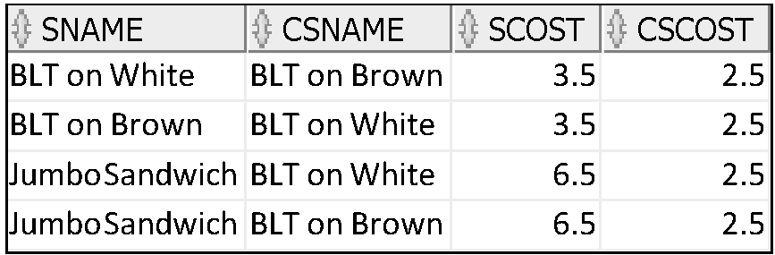
Join Non Equi Join
Select s.sname, p.csname, s.scost, p.cscost
from sandwich s
join csandwich p on (s.scost > p.cscost and p.csname <> s.sname);

Slide 20
Joining Tables Using SQL:1999 Syntax
Use a join to query data from more than one table:
SELECT table1.column, table2.column
FROM table1
[NATURAL JOIN table2] |
[JOIN table2 USING (column_name)] |
[JOIN table2
ON (table1.column_name = table2.column_name)]|
[LEFT|RIGHT|FULL OUTER JOIN table2
ON (table1.column_name = table2.column_name)]|
[CROSS JOIN table2];
An instruction to a database to combine data from more than one table.
Notes:
Defining Joins
In the syntax:
table1.column denotes the table and column from which data is retrieved
NATURAL JOIN joins two tables based on the same column name
JOIN table USING column_name performs an equijoin based on the column name
JOIN table ON table1.column_name performs an equijoin based on the condition in the ON clause, = table2.column_name
LEFT/RIGHT/FULL OUTER is used to perform outer joins
CROSS JOIN returns a Cartesian product from the two tables
For more information, see “SELECT” in Oracle SQL Reference.

Slide 21
Joining Tables Using SQL:1999 Syntax
Use a join to query data from more than one table:
SELECT table1.column, table2.column
FROM table1
[NATURAL JOIN table2] |
[JOIN table2 USING (column_name)] |
[JOIN table2
ON (table1.column_name = table2.column_name)];
NATURAL JOIN joins two tables based on the same column name
You don’t specify the name of the column, Oracle will match on ALL columns that have the same name in both tables
Notes:
Defining Joins
In the syntax:
table1.column denotes the table and column from which data is retrieved
NATURAL JOIN joins two tables based on the same column name
JOIN table USING column_name performs an equijoin based on the column name
JOIN table ON table1.column_name performs an equijoin based on the condition in the ON clause, = table2.column_name
LEFT/RIGHT/FULL OUTER is used to perform outer joins
CROSS JOIN returns a Cartesian product from the two tables
For more information, see “SELECT” in Oracle SQL Reference.

Slide 22
Joining Tables Using SQL:1999 Syntax
Use a join to query data from more than one table:
SELECT table1.column, table2.column
FROM table1
[NATURAL JOIN table2] |
[JOIN table2 USING (column_name)] |
[JOIN table2
ON (table1.column_name = table2.column_name)];
JOIN table USING column_name performs an equijoin based on the column name but the column must be of the same datatype
Notes:
Defining Joins
In the syntax:
table1.column denotes the table and column from which data is retrieved
NATURAL JOIN joins two tables based on the same column name
JOIN table ON table1.column_name performs an equijoin based on the condition in the ON clause, = table2.column_name
LEFT/RIGHT/FULL OUTER is used to perform outer joins
CROSS JOIN returns a Cartesian product from the two tables
For more information, see “SELECT” in Oracle SQL Reference.

Slide 23
Joining Tables Using SQL:1999 Syntax
Use a join to query data from more than one table:
SELECT table1.column, table2.column
FROM table1
[NATURAL JOIN table2] |
[JOIN table2 USING (column_name)] |
[JOIN table2
ON (table1.column_name = table2.column_name)]
;
JOIN table ON table1.column_name performs an equijoin based on the condition in the ON clause, = table2.column_name
You don’t need to prefix with the table name but it can be helpful to know what columns come from where
Notes:
Defining Joins
In the syntax:
table1.column denotes the table and column from which data is retrieved
NATURAL JOIN joins two tables based on the same column name
JOIN table ON table1.column_name performs an equijoin based on the condition in the ON clause, = table2.column_name
LEFT/RIGHT/FULL OUTER is used to perform outer joins
CROSS JOIN returns a Cartesian product from the two tables
For more information, see “SELECT” in Oracle SQL Reference.

Slide 24
Tutorial Part I
L6-Tut1-Joins.pdf
L6-Tut-PT1-Template.sql

Slide 25
SQL Functions
Data Manipulation Language

Slide 26
SQL Functions
Functions are a very powerful feature of SQL.
They can be used to do the following:
Perform calculations on data
Modify individual data items
Manipulate output for groups of rows
Format dates and numbers for display
Convert column data types
SQL functions sometimes take arguments and always return a value.
Most of the functions that are described in this lesson are specific to the Oracle version of SQL.

Slide 27
SQL Functions
Input
Output
Function
arg 1
Function performs action
arg 2
Result
value
arg n
Notes:
SQL Functions
Note:

Slide 28
Two Types of SQL Functions
Functions
Single-row
functions
Multiple-row
functions
Return one result
per row
Return one result
per set of rows
Notes:
SQL Functions (continued)
There are two types of functions:
Single-row functions
Multiple-row functions
Single-Row Functions
These functions operate on single rows only and return one result per row. There are different types of single-row functions. This lesson covers the following ones:
Character
Number
Date
Conversion
General
Multiple-Row Functions
Functions can manipulate groups of rows to give one result per group of rows. These functions are also known as group functions (covered in a later lesson).
Note: For more information and a complete list of available functions and their syntax, see Oracle SQL Reference.

Slide 29
SQL Functions
Single-Row Functions
Acts on each row
Can accept multiple arguments
Column name
Variable name
Expression
Constant
Returns a single value for each row

Slide 30
Single-Row Functions
Single-row functions:
Manipulate data items
Accept arguments and return one value
Act on each row that is returned
Return one result per row
May return a value of a data type different to that referenced
Can be nested
Accept arguments that can be a column or an expression
function_name [(arg1, arg2,...)]
Notes:
Single-Row Functions
Single-row functions are used to manipulate data items. They accept one or more arguments and return one value for each row that is returned by the query. An argument can be one of the following:
User-supplied constant
Variable value
Column name
Expression
Features of single-row functions include:
Acting on each row that is returned in the query
Returning one result per row
Possibly returning a data value of a different type than the one that is referenced
Possibly expecting one or more arguments
Can be used in SELECT, WHERE, and ORDER BY clauses; can be nested
In the syntax:
function_name is the name of the function
arg1, arg2 is any argument to be used by the function. This can be represented by a column name or expression.

Slide 31
Single-Row Functions
An argument can be one of the following:
User-supplied constant
Variable value
Column name
Expression
Can be used in
Select
Where
Order By
Constraint
Any where a column name can be used
function_name [(arg1, arg2,...)]
Notes:
Single-Row Functions
Single-row functions are used to manipulate data items. They accept one or more arguments and return one value for each row that is returned by the query. An argument can be one of the following:
User-supplied constant
Variable value
Column name
Expression
Features of single-row functions include:
Acting on each row that is returned in the query
Returning one result per row
Possibly returning a data value of a different type than the one that is referenced
Possibly expecting one or more arguments
Can be used in SELECT, WHERE, and ORDER BY clauses; can be nested
In the syntax:
function_name is the name of the function
arg1, arg2 is any argument to be used by the function. This can be represented by a column name or expression.

Slide 32
Single-Row Functions
Character
Accept character input
Returns a single value
Can return both character and numeric values
Handle NULL values or selection of return value based on choices
General
Single-row
functions
Number
Accepts numeric input
Returns a single numeric value
\
Conversion
Date
Convert a value from one data type to another
Operate on date data type
Returns a value of date data type
Notes:
Single-Row Functions (continued)
This lesson covers the following single-row functions:
Character functions: Αccept character input and can return both character and number values
Number functions: Accept numeric input and return numeric values
Date functions: Operate on values of the DATE data type (All date functions return a value of DATE data type except the MONTHS_BETWEEN function, which returns a number.)
Conversion functions: Convert a value from one data type to another
General functions:
NVL
NVL2
NULLIF
COALESCE
CASE
DECODE

Slide 33
Character
functions
Case-manipulation
functions
Function | Result
LOWER('SQL Course') | sql course
UPPER('SQL Course') | SQL COURSE
INITCAP('SQL Course') | Sql Course
Notes:
Character Functions
Single-row character functions accept character data as input and can return both character and numeric values. Character functions can be divided into the following:
Case-manipulation functions
Character-manipulation functions
Note: The functions discussed in this lesson are only some of the available functions.

Slide 34
Character
functions
Client
clientID | Number(6)
Fullname | Varchar2(20)
Case-manipulation
functions
clientId | Fullname
1 | Joe Bloggs
1 | Jim bloogs
Function | Result
Select LOWER(fullname) from client; | joe bloggs jim bloogs
Select UPPER(fullname) from client; | JOE BLOGGS JIM BLOOGS
Select INITCAP(fullname) from client; | Joe Bloggs Jim Bloogs
Notes:
Character Functions
Single-row character functions accept character data as input and can return both character and numeric values. Character functions can be divided into the following:
Case-manipulation functions
Character-manipulation functions
Note: The functions discussed in this lesson are only some of the available functions.

Slide 35
Character
functions
Character-manipulation
functions
Function | Result
CONCAT('Hello', 'World') | HelloWorld
SUBSTR('HelloWorld',1,5) | Hello
LENGTH('HelloWorld') | 10
INSTR('HelloWorld', 'W') | 6
LPAD(salary,10,'*') | *****24000
RPAD(salary, 10, '*') | 24000*****
REPLACE ('JACK and JUE','J','BL') | BLACK and BLUE
TRIM('H' FROM 'HelloWorld') | elloWorld
Notes:
Character Functions
Single-row character functions accept character data as input and can return both character and numeric values. Character functions can be divided into the following:
Case-manipulation functions
Character-manipulation functions
Note: The functions discussed in this lesson are only some of the available functions.

Slide 36
Using Case-Manipulation Functions in Where Clause
Display everything from the mm_game title for the game soma:
SELECT *
FROM mm_game
WHERE game_title = 'soma';
no rows selected
SELECT *
FROM mm_game
WHERE LOWER(game_title) = 'soma';
Note: This does not change the case in the output – still as it is in the table.

Slide 37
Using Case-Manipulation Functions in the column list
Display the title from mm_game in lowercase for the game Soma:
SELECT LOWER(game_title)
FROM mm_game
WHERE LOWER(game_title) = ‘soma';

Slide 38
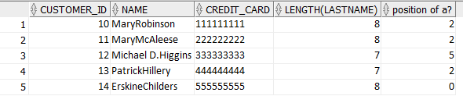
Using the Character-Manipulation Functions
Gives the output an ‘ALIAS’
1
SELECT customer_id, CONCAT(firstname, lastname) NAME,
credit_card, LENGTH (lastname),
INSTR(firstname, 'a') "position of a?"
FROM mm_customer;
2
3
2
3
1

Slide 39
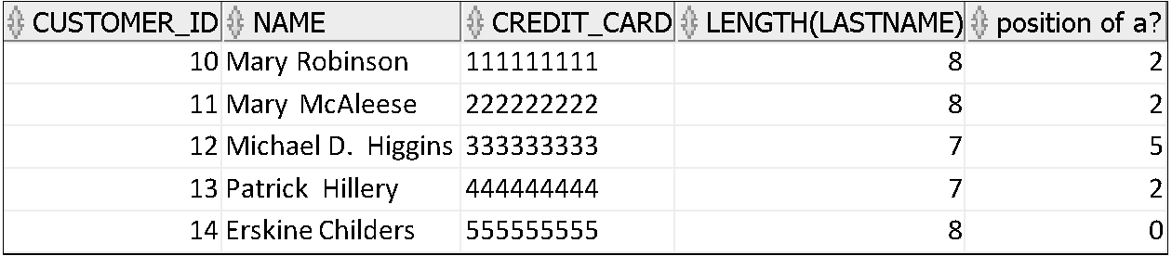
Using the Character-Manipulation Functions – Nesting Functions
1
NESTED CONCAT
SELECT customer_id, CONCAT(CONCAT(firstname, ' '),lastname) "NAME",
credit_card, LENGTH (lastname),
INSTR(firstname, 'a') "position of a?"
FROM mm_customer;
2
3
1
2
3

Slide 40
Using the Character-Manipulation Functions
To display the customers from the previous query whose last name end with the letter y:
SELECT customer_id, CONCAT(firstname, lastname) NAME,
credit_card, LENGTH (lastname),
INSTR(firstname, 'a') "position of a?"
FROM mm_customer
WHERE SUBSTR(lastname,-1, 1) = 'y';
SUBSTR (If parameter for starting position is negative, the count starts from the end of the character argument.
If length of substring required is omitted, all characters to the end of the string are returned.)
Notes:
Modify the SQL statement in the slide to display the data for those members whose last names start with the letter n.

Slide 41
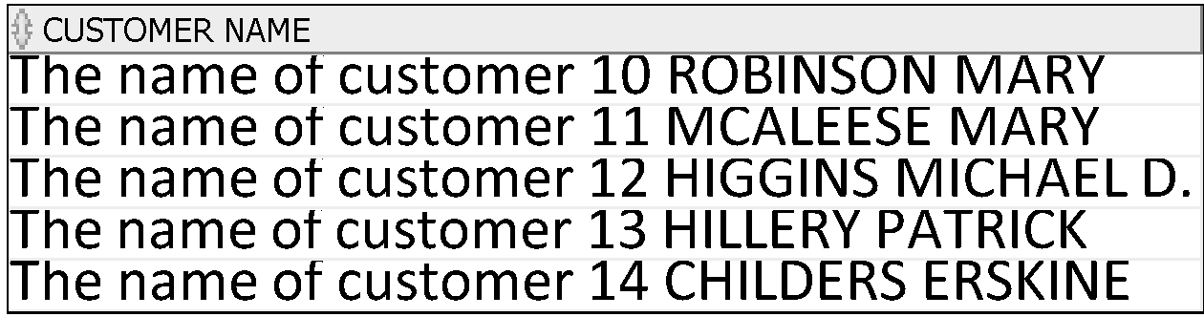
Using the Character-Manipulation Functions
ALTERNATE CONCATENATE
SELECT 'The name of customer '||customer_id || ' '
||UPPER(lastname)||' '
||UPPER(firstname) AS "CUSTOMER NAME"
FROM mm_customer;

Slide 42
Character
functions
Case-manipulation
functions
Character-manipulation
functions
LOWER
UPPER
INITCAP
CONCAT
SUBSTR
LENGTH
INSTR
LPAD
RPAD
TRIM
REPLACE
Notes:
Character Functions
Single-row character functions accept character data as input and can return both character and numeric values. Character functions can be divided into the following:
Case-manipulation functions
Character-manipulation functions
Note: The functions discussed in this lesson are only some of the available functions.

Slide 43
Nesting Functions
Single-row functions can be nested to any level.
Nested functions are evaluated from deepest level to the least deep level.
F3(F2(F1(col,arg1),arg2),arg3)
Step 1 = Result 1
Step 2 = Result 2
Step 3 = Result 3
Notes:
Nesting Functions
Single-row functions can be nested to any depth. Nested functions are evaluated from the innermost level to the outermost level. Some examples follow to show you the flexibility of these functions.

Slide 44
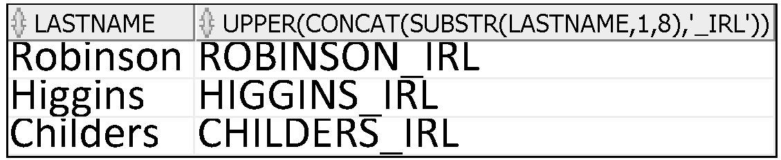
Nesting Functions
SELECT LASTNAME,
UPPER(CONCAT(SUBSTR (LASTNAME, 1, 8), '_IRL'))
FROM MM_CUSTOMER
WHERE CUSTOMER_ID IN(10,12,14);
This displays the last names of employees in department 60. The evaluation of the SQL statement involves three steps:
1. The inner function retrieves the first eight characters of the last name.
Result1 = SUBSTR (LAST_NAME, 1, 8)
2. The outer function concatenates the result with _US.
Result2 = CONCAT(Result1, '_US')
3. The outermost function converts the results to uppercase.
The entire expression becomes the column heading because no column alias was given.

Slide 45
Number Functions
ROUND: Rounds value to specified decimal
TRUNC: Truncates value to specified decimal
MOD: Returns remainder of division
Function | Result
ROUND(45.926, 2) | 45.93
TRUNC(45.926, 2) | 45.92
MOD(15,4) | 3
Notes:
Number Functions
Number functions accept numeric input and return numeric values. This section describes some of the number functions.
Note: This list contains only some of the available number functions.
For more information, see “Number Functions” in Oracle SQL Reference.

Slide 46
Using the ROUND Function
Negative second argument indicates round to the left of the decimal point
1
2
SELECT ROUND(45.923,2), ROUND(45.923,0),
ROUND(45.923,-1)
FROM DUAL;
3
1
2
3
DUAL is a dummy table that you can use to view results
from functions and calculations.
Notes:
ROUND Function
The ROUND function rounds the column, expression, or value to n decimal places. If the second argument is 0 or is missing, the value is rounded to zero decimal places. If the second argument is 2, the value is rounded to two decimal places. Conversely, if the second argument is –2, the value is rounded to two decimal places to the left (rounded to the nearest unit of 10).
The ROUND function can also be used with date functions. You will see examples later in this lesson.
DUAL Table
The DUAL table is owned by the user SYS and can be accessed by all users. It contains one column, DUMMY, and one row with the value X. The DUAL table is useful when you want to return a value once only (for example, the value of a constant, pseudocolumn, or expression that is not derived from a table with user data). The DUAL table is generally used for SELECT clause syntax completeness, because both SELECT and FROM clauses are mandatory, and several calculations do not need to select from actual tables.

Slide 47
Using the TRUNC Function
1
2
SELECT TRUNC(45.923,2), TRUNC(45.923),
TRUNC(45.923,-1)
FROM DUAL;
3
1
2
3
With negative second argument, TRUNC will make value zero to left of decimal point so 45 becomes 40
Notes:
TRUNC Function
The TRUNC function truncates the column, expression, or value to n decimal places.
The TRUNC function works with arguments similar to those of the ROUND function. If the second argument is 0 or is missing, the value is truncated to zero decimal places. If the second argument is 2, the value is truncated to two decimal places. Conversely, if the second argument is –2, the value is truncated to two decimal places to the left. If the second argument is –1, the value is truncated to one decimal place to the left.
Like the ROUND function, the TRUNC function can be used with date functions.

Slide 48
Working with Dates
The Oracle database stores dates in an internal numeric format: century, year, month, day, hours, minutes, and seconds.
The default date display format is DD-MON-RR.
Valid Oracle dates are between January 1, 4712 B.C., and December 31, 9999 A.D.
Notes:
Oracle Date Format
The Oracle database stores dates in an internal numeric format, representing the century, year, month, day, hours, minutes, and seconds.
The default display and input format for any date is DD-MON-RR. Valid Oracle dates are between January 1, 4712 B.C., and December 31, 9999 A.D.
In the example in the slide, the HIRE_DATE column output is displayed in the default format DD-MON-RR. However, dates are not stored in the database in this format. All the components of the date and time are stored. So, although a HIRE_DATE such as 17-JUN-87 is displayed as day, month, and year, there is also time and century information associated with the date. The complete data might be June 17, 1987, 5:10:43 p.m.

Slide 49
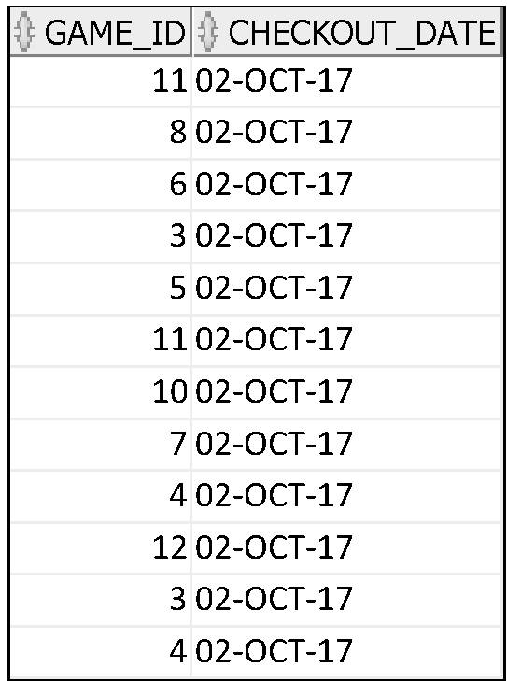
Working with Dates
SELECT game_id, checkout_date
FROM mm_rental
WHERE checkout_date < '05-OCT-17';
Look at the order in which the data is returned – Why?
This is in the order of the primary key
Notes:
Oracle Date Format
The Oracle database stores dates in an internal numeric format, representing the century, year, month, day, hours, minutes, and seconds.
The default display and input format for any date is DD-MON-RR. Valid Oracle dates are between January 1, 4712 B.C., and December 31, 9999 A.D.
In the example in the slide, the HIRE_DATE column output is displayed in the default format DD-MON-RR. However, dates are not stored in the database in this format. All the components of the date and time are stored. So, although a HIRE_DATE such as 17-JUN-87 is displayed as day, month, and year, there is also time and century information associated with the date. The complete data might be June 17, 1987, 5:10:43 p.m.

Slide 50
Working with Dates
SYSDATE is a function that returns:
Date
Time
Display the current date using the DUAL table
Select SYSDATE from Dual;
Notes:
SYSDATE Function
SYSDATE is a date function that returns the current database server date and time. You can use SYSDATE just as you would use any other column name. For example, you can display the current date by selecting SYSDATE from a table. It is customary to select SYSDATE from a dummy table called DUAL.
Example
Display the current date using the DUAL table.
SELECT SYSDATE FROM DUAL;

Slide 51
Arithmetic with Dates
Oracle provides the capability to perform date arithmetic.
You can add or subtract a number to or from a date for a resultant date value.
For example, if you add seven (7) to a value stored in a date column, Oracle will produce a date that is one week later than the stored date.
Adding 7 is equivalent to adding 7 days to the date.
You can add hours to a date by dividing the number of hours by 24.
You can compute the difference between two dates by subtracting two dates to find the number of days between those dates.
Notes:
Arithmetic with Dates
Because the database stores dates as numbers, you can perform calculations using arithmetic operators such as addition and subtraction. You can add and subtract number constants as well as dates.
You can perform the following operations:

Slide 52
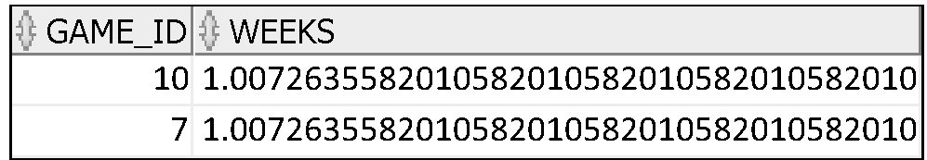
Using Arithmetic Operators with Dates
SELECT game_id, (SYSDATE-checkout_date)/7 AS WEEKS
FROM mm_rental
WHERE customer_id = 14;
Subtracts the date a game was checked out from the current date (SYSDATE), divides the result by 7 to calculate the number of weeks a game has been borrowed.
Results are restricted to customer 14.
If a more current date is subtracted from an older date, the difference is a negative number.

Slide 53
Date Functions
Function | Result
MONTHS_BETWEEN | Number of months between two dates
ADD_MONTHS | Add calendar months to date
NEXT_DAY | Next day of the date specified
LAST_DAY | Last day of the month
ROUND | Round date
TRUNC | Truncate date
Notes:
Date Functions
Date functions operate on Oracle dates. All date functions return a value of DATE data type except MONTHS_BETWEEN, which returns a numeric value.
MONTHS_BETWEEN(date1, date2): Finds the number of months between date1 and date2. The result can be positive or negative. If date1 is later than date2, the result is positive; if date1 is earlier than date2, the result is negative. The noninteger part of the result represents a portion of the month.
ADD_MONTHS(date, n): Adds n number of calendar months to date. The value of n must be an integer and can be negative.
NEXT_DAY(date, 'char'): Finds the date of the next specified day of the week ('char') following date. The value of char may be a number representing a day or a character string.
LAST_DAY(date): Finds the date of the last day of the month that contains date
ROUND(date[,'fmt']): Returns date rounded to the unit that is specified by the format model fmt. If the format model fmt is omitted, date is rounded to the nearest day.
TRUNC(date[, 'fmt']): Returns date with the time portion of the day truncated to the unit that is specified by the format model fmt. If the format model fmt is omitted, date is truncated to the nearest day.
This list is a subset of the available date functions. The format models are covered later in this lesson. Examples of format models are month and year.

Slide 54
Using Date Functions
Function | Result
MONTHS_BETWEEN ('01-SEP-95','11-JAN-94') | 19.6774194
ADD_MONTHS ('11-JAN-94',6) | '11-JUL-94'
NEXT_DAY ('01-SEP-95','FRIDAY') | '08-SEP-95'
LAST_DAY ('01-FEB-95') | '28-FEB-95'
Notes:
Date Functions (continued)
For example, display the employee number, hire date, number of months employed, six-month review date, first Friday after hire date, and last day of the hire month for all employees who have been employed for fewer than 36 months.
SELECT employee_id, hire_date,
MONTHS_BETWEEN (SYSDATE, hire_date) TENURE,
ADD_MONTHS (hire_date, 6) REVIEW,
NEXT_DAY (hire_date, 'FRIDAY'), LAST_DAY(hire_date)
FROM employees
WHERE MONTHS_BETWEEN (SYSDATE, hire_date) < 36;

Slide 55
Using Date Functions
Assume SYSDATE = '25-JUL-03':
Function | Result
ROUND(SYSDATE,'MONTH') | 01-AUG-03
ROUND(SYSDATE ,'YEAR') | 01-JAN-04
TRUNC(SYSDATE ,'MONTH') | 01-JUL-03
TRUNC(SYSDATE ,'YEAR') | 01-JAN-03
Notes:
Date Functions (continued)
The ROUND and TRUNC functions can be used for number and date values. When used with dates, these functions round or truncate to the specified format model. Therefore, you can round dates to the nearest year or month.
Example
Compare the hire dates for all employees who started in 1997. Display the employee number, hire date, and start month using the ROUND and TRUNC functions.
SELECT employee_id, hire_date,
ROUND(hire_date, 'MONTH'), TRUNC(hire_date, 'MONTH')
FROM employees
WHERE hire_date LIKE '%97';

Slide 56
Tutorial Part 2
L6-Tut2-Func.pdf
L6-Tut2-Func-template.sql

Slide 57
General Single-Row Functions
General
NVL
NVL2
NULLIF
COALESCE
CASE
DECODE
Notes:
Single-Row Functions (continued)
This lesson covers the following single-row functions:
Character functions: Αccept character input and can return both character and number values
Number functions: Accept numeric input and return numeric values
Date functions: Operate on values of the DATE data type (All date functions return a value of DATE data type except the MONTHS_BETWEEN function, which returns a number.)
Conversion functions: Convert a value from one data type to another
General functions:
NVL
NVL2
NULLIF
COALESCE
CASE
DECODE

Slide 58
General Functions
The following functions work with any data type and pertain to using nulls:
NVL2 (expr1, expr2, expr3)
NULLIF (expr1, expr2)
COALESCE (expr1, expr2, ..., exprn)
Notes:
General Functions
These functions work with any data type and pertain to the use of null values in the expression list.
Note: For more information about the hundreds of functions available, see “Functions” in Oracle SQL Reference.

Slide 59
NVL Function
Converts a null value to an actual value:
NVL (expr1, expr2)
Data types that can be used are date, character, and number.
Data types must match:
NVL(return_date,SYSDATE+7)
NVL(game_title, ‘No title provided’)
NVL(game_price, 0.00)
Notes:
NVL Function
To convert a null value to an actual value, use the NVL function.
Syntax
NVL (expr1, expr2)
In the syntax:
expr1 is the source value or expression that may contain a null
expr2 is the target value for converting the null
You can use the NVL function to convert any data type, but the return value is always the same as the data type of expr1.
NVL Conversions for Various Data Types

Slide 60
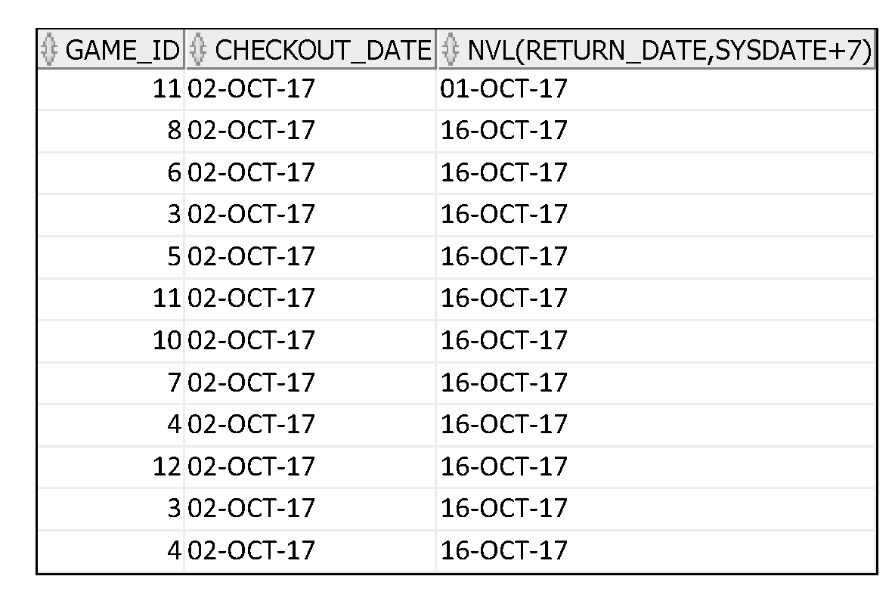
Using the NVL Function
1
SELECT game_id, checkout_date, NVL(return_date, sysdate+7)
FROM mm_rental;
1

Slide 61
Using the NVL2 Function
1
SELECT lastname, firstname,
NVL2(on_mailing_list,
'Signed Up', 'Not Signedup') ListStatus
FROM mm_customer;
The NVL2 function examines the first expression.
If the first expression is not null, then it returns the second expression.
If the first expression is null, then the third expression is returned.
Notes:
Using the NVL2 Function
The NVL2 function examines the first expression. If the first expression is not null, then the NVL2 function returns the second expression. If the first expression is null, then the third expression is returned.
Syntax
NVL2(expr1, expr2, expr3)
In the syntax:
expr1 is the source value or expression that may contain null
expr2 is the value that is returned if expr1 is not null
expr3 is the value that is returned if expr2 is null
In the example shown in the slide, the MAILING_LIST column is examined. If a value is detected, the second expression of SAL+COMM is returned. If the MAILING_LIST column holds a null value, the third expression of LISTSTATUS returned.
The argument expr1 can have any data type. The arguments expr2 and expr3 can have any data types except LONG. If the data types of expr2 and expr3 are different, the Oracle server converts expr3 to the data type of expr2 before comparing them unless expr3 is a null constant. In the latter case, a data type conversion is not necessary. The data type of the return value is always the same as the data type of expr2, unless expr2 is character data, in which case the return value’s data type is VARCHAR2.

Slide 62
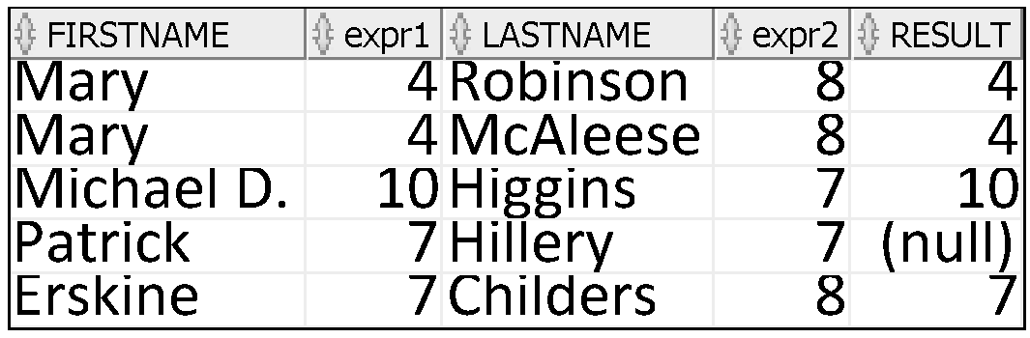
Using the NULLIF Function
The NULLIF function compares two expressions. If they are equal, the function returns null. If they are not equal, the function returns the first expression. You cannot specify the literal NULL for the first expression.
1
SELECT firstname, LENGTH(firstname) "expr1",
lastname, LENGTH(lastname) "expr2",
NULLIF(LENGTH(firstname), LENGTH(lastname)) result
FROM MM_CUSTOMER;
2
3
1
2
3
Notes:
Using the NULLIF Function
The NULLIF function compares two expressions. If they are equal, the function returns null. If they are not equal, the function returns the first expression. You cannot specify the literal NULL for the first expression.
Syntax
NULLIF (expr1, expr2)
In the syntax:
expr1 is the source value compared to expr2
expr2 is the source value compared with expr1 (If it is not equal to expr1, expr1 is returned.)
In the example shown in the slide, the length of the first name in the MM_MEMBER table is compared to the length of the last name in the MM_MEMBER table. When the lengths of the names are equal, a null value is displayed. When the lengths of the names are not equal, the length of the first name is displayed.
Note: The NULLIF function is logically equivalent to the following CASE expression. The CASE expression is discussed on a subsequent page:
CASE WHEN expr1 = expr 2 THEN NULL ELSE expr1 END

Slide 63
Using the COALESCE Function
The advantage of the COALESCE function over the NVL function is that the COALESCE function can take multiple alternate values.
If the first expression is not null, the COALESCE function returns that expression; otherwise, it does a COALESCE of the remaining expressions.
Notes:
Using the COALESCE Function
The COALESCE function returns the first non-null expression in the list.
Syntax
COALESCE (expr1, expr2, ... exprn)
In the syntax:
expr1 returns this expression if it is not null
expr2 returns this expression if the first expression is null and this expression is not null
exprn returns this expression if the preceding expressions are null
All expressions must be of the same data type.

Slide 64
Using the COALESCE Function
SELECT game_id,
COALESCE(return_date,sysdate+7) CHECKIN
FROM mm_rental
ORDER BY return_date;
Notes:
Using the COALESCE Function (continued)
In the example shown in the slide, if the MANAGER_ID value is not null, it is displayed. If the MANAGER_ID value is null, then the COMMISSION_PCT is displayed. If the MANAGER_ID and COMMISSION_PCT values are null, then the value –1 is displayed.

Slide 65
Using the COALESCE Function
SELECT customer_id,
COALESCE(firstname, lastname, 'Both names are null')
FROM mm_customer;
In this case if the firstname is null, the lastname will be returned, if the lastname is null then
Both names are null will be returned
Notes:
Using the COALESCE Function (continued)
In the example shown in the slide, if the MANAGER_ID value is not null, it is displayed. If the MANAGER_ID value is null, then the COMMISSION_PCT is displayed. If the MANAGER_ID and COMMISSION_PCT values are null, then the value –1 is displayed.

Slide 66
Conditional Expressions
Provide the use of IF-THEN-ELSE logic within a SQL statement
Use two methods:
CASE expression
DECODE function
Notes:
Conditional Expressions
Two methods used to implement conditional processing (IF-THEN-ELSE logic) in a SQL statement are the CASE expression and the DECODE function.
Note: The CASE expression complies with ANSI SQL. The DECODE function is specific to Oracle syntax.

Slide 67
CASE Expression
Facilitates conditional inquiries by doing the work of an IF-THEN-ELSE statement:
CASE expr WHEN comparison_expr1 THEN return_expr1
[WHEN comparison_expr2 THEN return_expr2
WHEN comparison_exprn THEN return_exprn
ELSE else_expr]
END
Data types of the CASE, WHEN, and ELSE expressions must be the same.
Notes:
CASE Expression
CASE expressions let you use IF-THEN-ELSE logic in SQL statements without having to invoke procedures.
In a simple CASE expression, the Oracle server searches for the first WHEN ... THEN pair for which expr is equal to comparison_expr and returns return_expr. If none of the WHEN ... THEN pairs meet this condition, and if an ELSE clause exists, then the Oracle server returns else_expr. Otherwise, the Oracle server returns null. You cannot specify the literal NULL for all the return_exprs and the else_expr.
All of the expressions ( expr, comparison_expr, and return_expr) must be of the same data type, which can be CHAR, VARCHAR2, NCHAR, or NVARCHAR2.

Slide 68
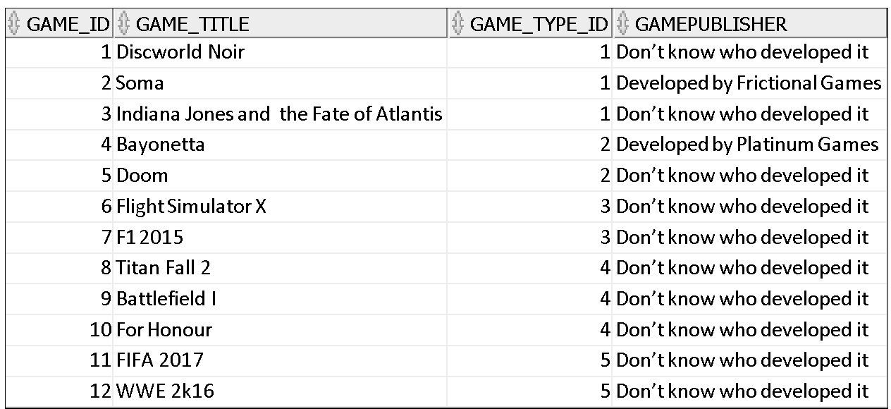
Simple Example
SELECT game_id, game_title, game_type_id,
CASE game_title
WHEN 'Soma' THEN 'Developed by Frictional Games'
WHEN 'Bayonetta' THEN 'Developed by Platinum Games'
ELSE 'Don’t know who developed it'
END
AS GAMEPUBLISHER
FROM mm_game;

Slide 69
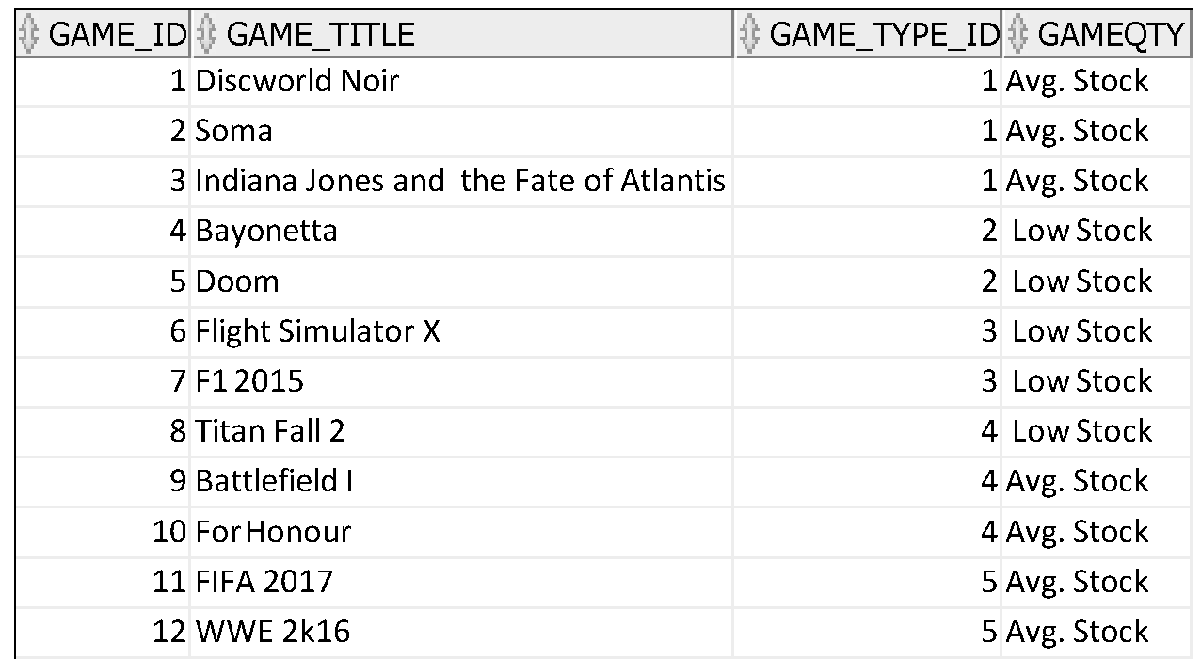
Simple Case Expression
SELECT game_id, game_title, game_type_id,
CASE
WHEN game_qty<3 THEN ' Low Stock'
WHEN game_qty>2 and game_qty < 12 THEN 'Avg. Stock'
ELSE 'Lots of stock'
END
AS GAMEQTY
FROM mm_game;
The data type of the return value need not be the same with the CASE expression.

Slide 70
Using the CASE Expression
The value of GAME_TYPE_ID is decoded:
If GAME_TYPE_ID is 1, the price increase is 10%;
If GAME_TYPE_ID is 2, the price increase is 15%;
If GAME_TYPE_id is 3, the price increase is 20%.
For all other game types , there is no increase in price.
NOTE: this doesn’t change the actual data, just the values output
SELECT game_title, game_type_id,
CASE game_type_id
WHEN 1 THEN 1.10*game_price
WHEN 2 THEN 1.15*game_price
WHEN 3 THEN 1.20*game_price
ELSE game_price
END “PRICE NEXT MONTH"
FROM mm_game;
Notes:
Using the CASE Expression
The same statement can be written with the DECODE function.
This is an example of a searched CASE expression. In a searched CASE expression, the search occurs from left to right until an occurrence of the listed condition is found, and then it returns the return expression. If no condition is found to be true, and if an ELSE clause exists, the return expression in the ELSE clause is returned; otherwise, NULL is returned.
SELECT last_name,salary,
(CASE WHEN salary<5000 THEN 'Low'
WHEN salary<10000 THEN 'Medium'
WHEN salary<20000 THEN 'Good'
ELSE 'Excellent'
END) qualified_salary
FROM employees;

Slide 71
DECODE Function
The DECODE function enables you to use If-Then-Else logic when displaying values.
The general format is:
The expression can be a column value of any datatype or a result from some type of computation or function.
The expression is compared to search1 and if expression = search1, then result1 is returned. If not, then the search continues to compare expression = search2 in order to return result2, etc.
If the expression does not equal any of the search values, then the default value is returned.
The else default can be a column value or the result of some type of computation or function.
DECODE(col|expression, search1, result1
[, search2, result2,...,]
[, default])

Slide 72
Using the DECODE Function
SELECT game_title, game_type_id,
DECODE (game_type_id,
1,1.10*game_price,
2,1.15*game_price,
3,1.20*game_price,
game_price) "REVISED_PRICE"
FROM mm_game;
This achieves the same outcome as we save for the CASE Statement for increasing the price
Notes:
Using the DECODE Function
In the SQL statement in the slide, the value of JOB_ID is tested. If JOB_ID is IT_PROG, the salary increase is 10%; if JOB_ID is ST_CLERK, the salary increase is 15%; if JOB_ID is SA_REP, the salary increase is 20%. For all other job roles, there is no increase in salary.
The same statement can be expressed in pseudocode as an IF-THEN-ELSE statement:
IF job_id = 'IT_PROG' THEN salary = salary*1.10
IF job_id = 'ST_CLERK' THEN salary = salary*1.15
IF job_id = 'SA_REP' THEN salary = salary*1.20
ELSE salary = salary

Slide 73
DECODE Expression
DECODE(columnl|expression, search1,result1
[, search2, result2,...,]
[, default])
The DECODE function evaluates an expression in a similar way to the IF-THEN-ELSE logic.
DECODE compares an expression to each of the search values.
If the default value is omitted, a null value is returned where a search value does not match any of the values.

Slide 74
Tutorial Part 3
L6-Tut3-Func.pdf
L6-Tut3-Func-template.sql

Slide 75
Conversion Functions
Data type conversion
Implicit data type
conversion
Explicit data type
conversion
VARCHAR2 OR CHAR TO NUMBER
VARCHAR2 OR CHAR TO DATE
NUMBER TO VARCHAR2 OR CHAR
DATE TO VARCHAR2 OR CHAR
TO_CHAR
TO_NUMBER
TO_DATE
Notes:
Conversion Functions
In addition to Oracle data types, columns of tables in an Oracle database can be defined using ANSI, DB2, and SQL/DS data types. However, the Oracle server internally converts such data types to Oracle data types.
In some cases, the Oracle server uses data of one data type where it expects data of a different data type. When this happens, the Oracle server can automatically convert the data to the expected data type. This data type conversion can be done implicitly by the Oracle server or explicitly by the user.
Implicit data type conversions work according to the rules that are explained in the next two slides.
Explicit data type conversions are done by using the conversion functions. Conversion functions convert a value from one data type to another. Generally, the form of the function names follows the convention data type TO data type. The first data type is the input data type; the second data type is the output.
Note: Although implicit data type conversion is available, it is recommended that you do explicit data type conversion to ensure the reliability of your SQL statements.

Slide 76
Implicit Data Type Conversion
For assignments, the Oracle server can automatically convert the following:
From | To
VARCHAR2 or CHAR | NUMBER
VARCHAR2 or CHAR | DATE
NUMBER | VARCHAR2
DATE | VARCHAR2
This is particularly relevant in where clauses:
For example, the expression hire_date > '01-JAN-90' results in the implicit conversion from the string '01-JAN-90' to a date.
Notes:
Implicit Data Type Conversion
The assignment succeeds if the Oracle server can convert the data type of the value used in the assignment to that of the assignment target.
For example, the expression hire_date > '01-JAN-90' results in the implicit conversion from the string '01-JAN-90' to a date.

Slide 77
Implicit Data Type Conversion
For expression evaluation, the Oracle Server can automatically convert the following:
From | To
VARCHAR2 or CHAR | NUMBER
VARCHAR2 or CHAR | DATE
For example, the expression salary = '20000' results in the implicit conversion of the string '20000' to the number 20000.
Note: CHAR to NUMBER conversions succeed only if the character string represents a valid number.
Notes:
Implicit Data Type Conversion (continued)
In general, the Oracle server uses the rule for expressions when a data type conversion is needed in places that are not covered by a rule for assignment conversions.
For example, the expression salary = '20000' results in the implicit conversion of the string '20000' to the number 20000.
Note: CHAR to NUMBER conversions succeed only if the character string represents a valid number.

Slide 78
Explicit Data Type Conversion
TO_NUMBER
TO_DATE
NUMBER
CHARACTER
DATE
TO_CHAR
TO_CHAR
Notes:
Explicit Data Type Conversion
SQL provides three functions to convert a value from one data type to another:

Slide 79
Using the TO_CHAR Function with Dates
TO_CHAR(date, 'format_model')
The format model:
Must be enclosed by single quotation marks
Is case-sensitive
Can include any valid date format element
Has an fm element to remove padded blanks or suppress leading zeros
Is separated from the date value by a comma
Notes:
Displaying a Date in a Specific Format
Previously, all Oracle date values were displayed in the DD-MON-YY format. You can use the TO_CHAR function to convert a date from this default format to one that you specify.
Guidelines
The format model must be enclosed by single quotation marks and is case-sensitive.
The format model can include any valid date format element. Be sure to separate the date value from the format model by a comma.
The names of days and months in the output are automatically padded with blanks.
To remove padded blanks or to suppress leading zeros, use the fill mode fm element.
You can format the resulting character field with the iSQL*Plus COLUMN command (covered in a later lesson).
SELECT employee_id, TO_CHAR(hire_date, 'MM/YY') Month_Hired
FROM employees
WHERE last_name = 'Higgins';

Slide 80
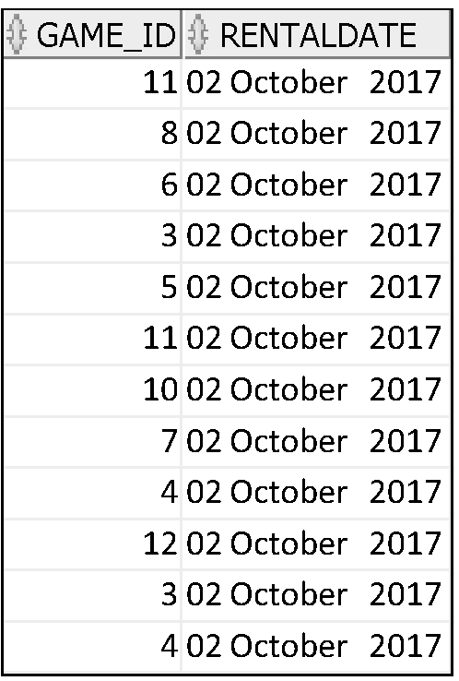
Using the TO_CHAR Function with Dates
SELECT game_id,
TO_CHAR(checkout_date, 'DD Month YYYY')
AS RENTALDATE
FROM MM_RENTAL;
Notes:
…

Slide 81
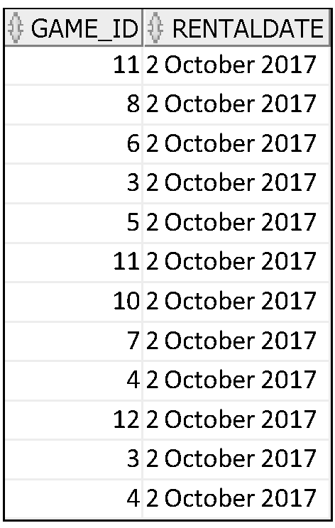
Using the TO_CHAR Function with Dates
SELECT game_id,
TO_CHAR(checkout_date, 'fmDD Month YYYY')
AS RENTALDATE
FROM MM_RENTAL;
fm controls whether padded blanks or leading zeros are shown
Notes:
…

Slide 82
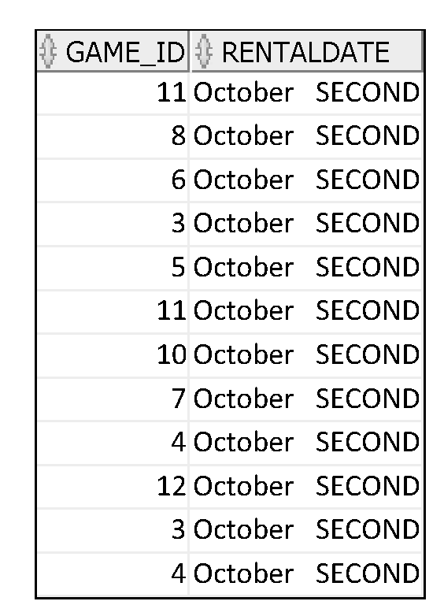
Using the TO_CHAR Function with Dates
SELECT game_id,
TO_char(checkout_date, 'Month DDspth')
AS RENTALDATE
FROM MM_RENTAL;
Notes:
…

Slide 83
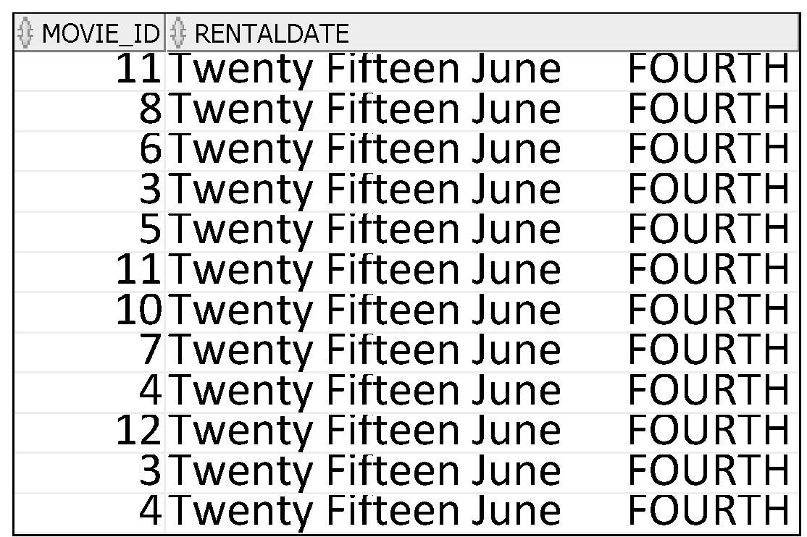
Using the TO_CHAR Function with Dates
SELECT game_id,
TO_char(checkout_date, ‘Year Month DDspth')
AS RENTALDATE
FROM MM_RENTAL;
Notes:
…

Slide 84
Date Format of to_char
Format | Output
D | Day of week (1-7)
DD | Day of week (1-31)
DAY | Name of day right padded to display blanks up to length of longest day name
MM | Month (1-12)
MON | Abbreviated Month Name
MONTH | Full Month Name
YEAR | Year spelt out
YYYY | 4 digit year
YY | 2 digit year
Suffixes for numbers:
TH e.g DDTH would be perhaps 4TH
SP spelled number DDSP FOUR
SPTH spelled number plus TH FOURTH

Slide 85
Using the TO_CHAR Function with Numbers
TO_CHAR(number, 'format_model') ddspth
These are some of the format elements that you can use with the TO_CHAR function to display a number value as a character:
Element | Result
9 | Represents a number
0 | Forces a zero to be displayed
$ | Places a floating dollar sign
U | Local currency sign
. | Prints a decimal point
, | Prints a comma as thousands indicator
Notes:
Using the TO_CHAR Function with Numbers
When working with number values such as character strings, you should convert those numbers to the character data type using the TO_CHAR function, which translates a value of NUMBER data type to VARCHAR2 data type. This technique is especially useful with concatenation.

Slide 86
Using the TO_CHAR Function with Numbers
SELECT TO_CHAR(game_price, '$99,999.00') GAMEVALUE
FROM MM_GAME
WHERE GAME_TITLE = ‘Soma';
Format Character
0 | Displays leading or trailing zeroes depending on position
9 | Returns value with the specified number of digits with a leading space if positive or with a leading minus if negative. Leading zeros are blank, except for a zero value, which returns a zero for the integer part of the fixed-point number.
$ | Dollar sign
U | Local currency sign
Notes:
Guidelines
The Oracle server displays a string of number signs (#) in place of a whole number whose digits exceed the number of digits that is provided in the format model.
The Oracle server rounds the stored decimal value to the number of decimal places that is provided in the format model.

Slide 87
Using the TO_CHAR Function with Numbers
SELECT TO_CHAR(game_price, ‘U99,999.00') GAMEVALUE
FROM MM_GAME
WHERE GAME_TITLE = 'Alien';
Format Character
0 | Displays leading or trailing zeroes depending on position
9 | Returns value with the specified number of digits with a leading space if positive or with a leading minus if negative. Leading zeros are blank, except for a zero value, which returns a zero for the integer part of the fixed-point number.
$ | Dollar sign
U | Local currency sign
Notes:
Guidelines
The Oracle server displays a string of number signs (#) in place of a whole number whose digits exceed the number of digits that is provided in the format model.
The Oracle server rounds the stored decimal value to the number of decimal places that is provided in the format model.

Slide 88
Using the TO_NUMBER and TO_DATE Functions
Convert a character string to a number format using the TO_NUMBER function:
Convert a character string to a date format using the TO_DATE function:
These functions have an fx modifier. This modifier specifies the exact matching for the character argument and date format model of a TO_DATE function.
TO_NUMBER(char[, 'format_model'])
TO_DATE(char[, 'format_model'])
Notes:
Using the TO_NUMBER and TO_DATE Functions
You may want to convert a character string to either a number or a date. To accomplish this task, use the TO_NUMBER or TO_DATE functions. The format model that you choose is based on the previously demonstrated format elements.
The fx modifier specifies exact matching for the character argument and date format model of a TO_DATE function:
Punctuation and quoted text in the character argument must exactly match (except for case) the corresponding parts of the format model.
The character argument cannot have extra blanks. Without fx, Oracle ignores extra blanks.
Numeric data in the character argument must have the same number of digits as the corresponding element in the format model. Without fx, numbers in the character argument can omit leading zeros.

Slide 89
Elements of the Date Format Model
Time elements format the time portion of the date:
Add character strings by enclosing them in double quotation marks:
Number suffixes spell out numbers:
HH24:MI:SS AM
15:45:32 PM
DD "of" MONTH
12 of OCTOBER
ddspth
fourteenth
Notes:
Date Format Elements: Time Formats
Use the formats that are listed in the following tables to display time information and literals and to change numerals to spelled numbers.

Slide 90
Tutorial Part 4
L6-Tut4-Func.pdf
L6-Tut4-Func-template.sql

Slide 91
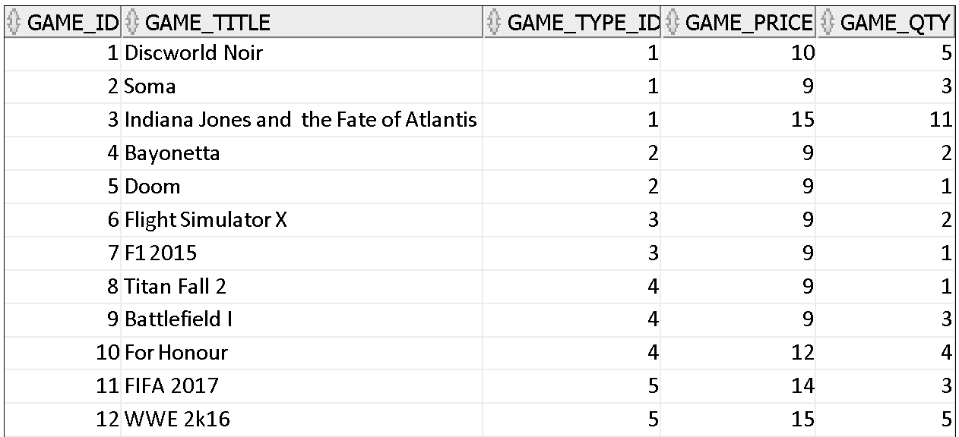
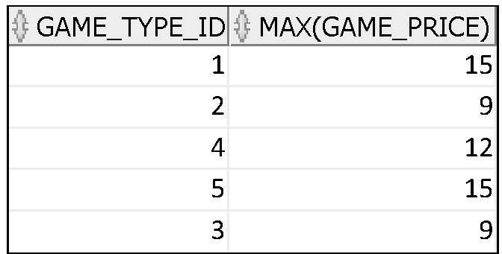
What Are Group Functions?
Group functions operate on sets of rows to give one result per group.
Maximum game
price in
MM_GAME
table for each GAME TYPE
Notes:
Group Functions
Unlike single-row functions, group functions operate on sets of rows to give one result per group. These sets may comprise the entire table or the table split into groups.

Slide 92
Types of Group Functions
AVG
COUNT
MAX
MIN
STDDEV
SUM
Group
functions
One row per group
Notes:
Types of Group Functions
Each of the functions accepts an argument. The following table identifies the options that you can use in the syntax:

Slide 93
Creating Groups of Data: GROUP BY Clause Syntax
You can divide rows in a table into smaller groups by using the GROUP BY clause.
SELECT column, group_function(column)
FROM table
[WHERE condition]
[GROUP BY group_by_expression]
[ORDER BY column];
Notes:
GROUP BY Clause
You can use the GROUP BY clause to divide the rows in a table into groups. You can then use the group functions to return summary information for each group.
In the syntax:
group_by_expression specifies columns whose values determine the basis for grouping rows
Guidelines
If you include a group function in a SELECT clause, you cannot select individual results as well, unless the individual column appears in the GROUP BY clause. You receive an error message if you fail to include the column list in the GROUP BY clause.
Using a WHERE clause, you can exclude rows before dividing them into groups.
You must include the columns in the GROUP BY clause.
You cannot use a column alias in the GROUP BY clause.

Slide 94
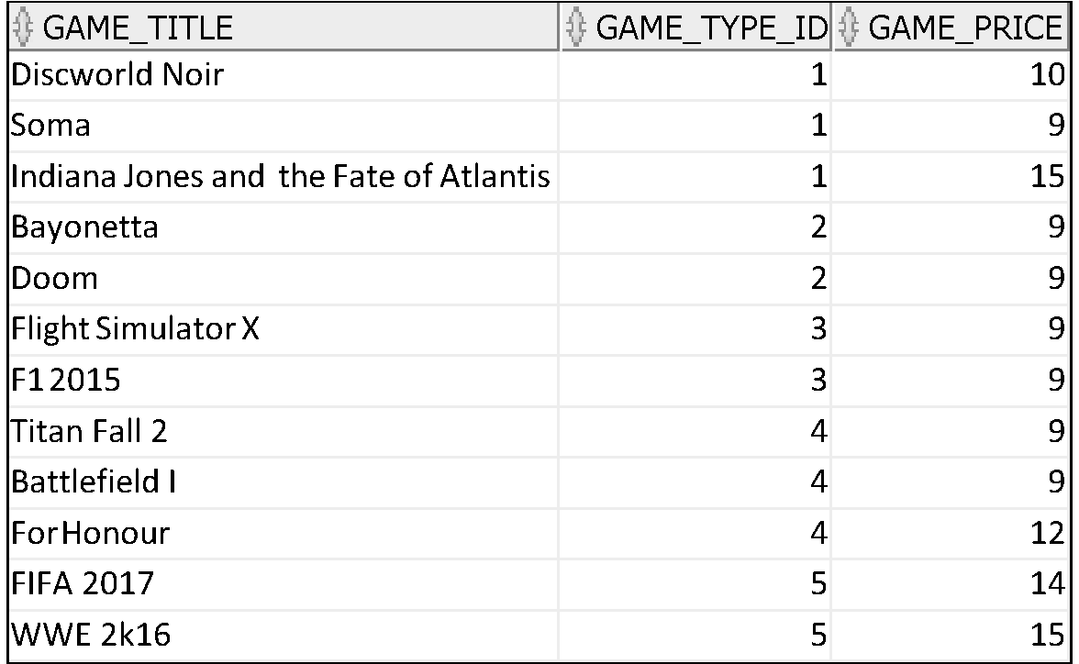
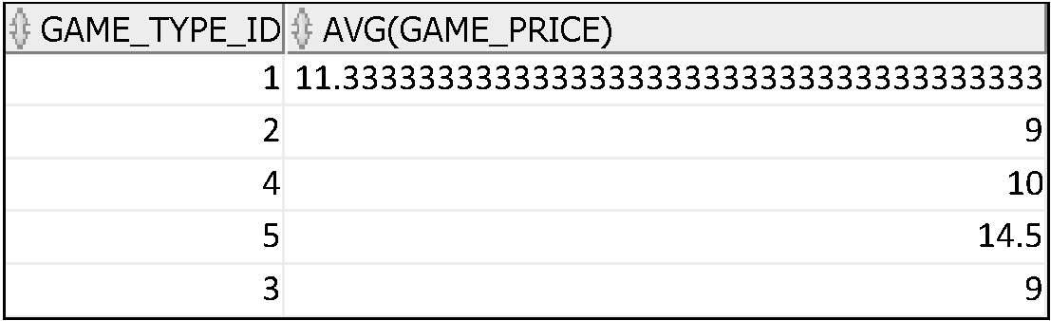
Creating Groups of Data
Average game_price for each game type
Notes:
Creating Groups of Data
Until this point in our discussion, all group functions have treated the table as one large group of information.
At times, however, you need to divide the table of information into smaller groups. This can be done by using the GROUP BY clause.

Slide 95
Using the GROUP BY Clause
The SELECT clause specifies the columns to be retrieved, as follows:
game_type_id column in the mm_game table
The rounded, average value of all games in the group that you specified in the GROUP BY clause
The FROM clause specifies the tables that the database must access: the MM_GAMES table.
The GROUP BY clause specifies how the groups should be formed for the function.
select game_type_id, round(avg(game_price),2)
as "Average game value"
from mm_game
group by game_type_id;
Notes:
Using the GROUP BY Clause
When using the GROUP BY clause, make sure that all columns in the SELECT list that are not group functions are included in the GROUP BY clause. The example in the slide displays the department number and the average salary for each department. Here is how this SELECT statement, containing a GROUP BY clause, is evaluated:
The SELECT clause specifies the columns to be retrieved, as follows:
game_type_id column in the mm_game table
The average value of all games in the group that you specified in the GROUP BY clause
The FROM clause specifies the tables that the database must access: the MM_GAMES table.
The WHERE clause specifies the rows to be retrieved. Because there is no WHERE clause, all rows are retrieved by default.
The GROUP BY clause specifies how the rows should be grouped. The rows are grouped by department number, so the AVG function that is applied to the salary column calculates the average game value for each game type

Slide 96
Using the GROUP BY Clause
The GROUP BY clause specifies how the rows should be grouped.
The rows are grouped by game type so the AVG function that is applied to the price column calculates the average game price for each game type
select game_type_id, round(avg(game_price),2)
as "Average game value"
from mm_game
group by game_type_id;
Notes:
Using the GROUP BY Clause
When using the GROUP BY clause, make sure that all columns in the SELECT list that are not group functions are included in the GROUP BY clause. The example in the slide displays the department number and the average salary for each department. Here is how this SELECT statement, containing a GROUP BY clause, is evaluated:
The SELECT clause specifies the columns to be retrieved, as follows:
game_type_id column in the mm_game table
The average value of all games in the group that you specified in the GROUP BY clause
The FROM clause specifies the tables that the database must access: the MM_GAMES table.
The WHERE clause specifies the rows to be retrieved. Because there is no WHERE clause, all rows are retrieved by default.
The GROUP BY clause specifies how the rows should be grouped. The rows are grouped by department number, so the AVG function that is applied to the salary column calculates the average game value for each game type

Slide 97
Using the GROUP BY Clause
When using the GROUP BY clause, make sure that all columns in the SELECT list that are not group functions are included in the GROUP BY clause.
select game_type_id, round(avg(game_price),2)
as "Average game value"
from mm_game
group by game_type_id;
Notes:
Using the GROUP BY Clause
When using the GROUP BY clause, make sure that all columns in the SELECT list that are not group functions are included in the GROUP BY clause. The example in the slide displays the department number and the average salary for each department. Here is how this SELECT statement, containing a GROUP BY clause, is evaluated:
The SELECT clause specifies the columns to be retrieved, as follows:
game_type_id column in the mm_game table
The average value of all games in the group that you specified in the GROUP BY clause
The FROM clause specifies the tables that the database must access: the MM_GAMES table.
The WHERE clause specifies the rows to be retrieved. Because there is no WHERE clause, all rows are retrieved by default.
The GROUP BY clause specifies how the rows should be grouped. The rows are grouped by department number, so the AVG function that is applied to the salary column calculates the average game value for each game type

Slide 98
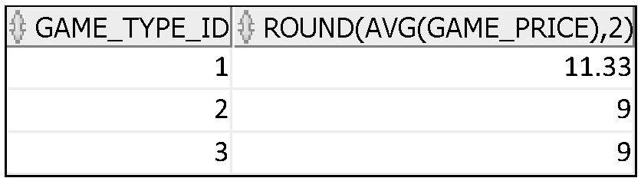
Using the GROUP BY Clause
The WHERE clause specifies what GOES INTO the group function
select game_type_id, round(avg(game_price),2)
as "Average game value"
from mm_game
Where game_type_id between 1 and 3
group by game_type_id;
Notes:
Using the GROUP BY Clause
When using the GROUP BY clause, make sure that all columns in the SELECT list that are not group functions are included in the GROUP BY clause. The example in the slide displays the department number and the average salary for each department. Here is how this SELECT statement, containing a GROUP BY clause, is evaluated:
The SELECT clause specifies the columns to be retrieved, as follows:
game_type_id column in the mm_game table
The average value of all games in the group that you specified in the GROUP BY clause
The FROM clause specifies the tables that the database must access: the MM_GAMES table.
The WHERE clause specifies the rows to be retrieved. Because there is no WHERE clause, all rows are retrieved by default.
The GROUP BY clause specifies how the rows should be grouped. The rows are grouped by department number, so the AVG function that is applied to the salary column calculates the average game value for each game type

Slide 99
Using the AVG and SUM Functions
You can use AVG and SUM for numeric data.
SELECT AVG(game_price), MAX(game_price),
MIN(game_price), SUM(game_price)
FROM mm_game
WHERE game_title LIKE '%a%';
The example displays the average, highest, lowest, and sum of all games with a lowercase a in their title
The GROUP by default is all rows in the table matching the where
Notes:
Using the Group Functions
You can use AVG, SUM, MIN, and MAX functions against columns that can store numeric data.

Slide 100
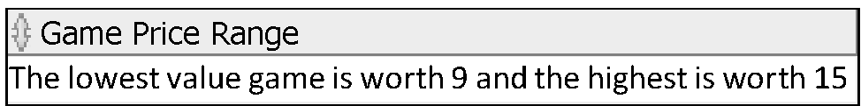
Using the MIN and MAX Functions
You can use MIN and MAX for numeric, character, and date data types.
SELECT 'The lowest value game is worth ' ||
MIN(game_price) ||
' and the highest is worth '||
MAX(game_price) as "Game Price Range"
FROM mm_game
Renamed in output
Notes:
Using the Group Functions (continued)
You can use the MAX and MIN functions for numeric, character, and date data types.
Note: The AVG, SUM, VARIANCE, and STDDEV functions can be used only with numeric data types. MAX and MIN cannot be used with LOB or LONG data types.

Slide 101

Using the MIN and MAX Functions
You can use MIN and MAX for numeric, character, and date data types.
SELECT MIN(lastname), MAX(lastname)
FROM mm_customer;
Displays the customer last name that is first and the member last name that is last in an alphabetized list of all members
Notes:
Using the Group Functions (continued)
You can use the MAX and MIN functions for numeric, character, and date data types. MAX and MIN cannot be used with LOB or LONG data types.

Slide 102
Using the COUNT Function
COUNT(*) returns the number of rows in a table:
COUNT(expr) returns the number of rows with non-null values for the expr:
SELECT COUNT(*)
FROM mm_game
WHERE game_title like '%a%';
1
SELECT COUNT(return_date)
FROM mm_rental;
2
Notes:
COUNT Function
The COUNT function has three formats:
COUNT(*)
COUNT(expr)
COUNT(DISTINCT expr)
COUNT(*) returns the number of rows in a table that satisfy the criteria of the SELECT statement, including duplicate rows and rows containing null values in any of the columns. If a WHERE clause is included in the SELECT statement, COUNT(*) returns the number of rows that satisfy the condition in the WHERE clause.
In contrast, COUNT(expr) returns the number of non-null values that are in the column identified by expr.
COUNT(DISTINCT expr) returns the number of unique, non-null values that are in the column identified by expr.
Examples
1. The slide example displays the number of games with an a in their title
2. The slide example displays the number of members signed up to the mailing list (nulls are not counted)

Slide 103
Group Functions and Null Values
Group functions ignore null values in the column:
The NVL function forces group functions to include null values:
1
SELECT MAX(return_date)
FROM MM_RENTAL;
SELECT MAX(NVL(return_date,checkout_date+7))
FROM MM_RENTAL;
2
Notes:
Group Functions and Null Values
All group functions ignore null values in the column.
The NVL function forces group functions to include null values.

Slide 104
Using the DISTINCT Keyword
COUNT(DISTINCT expr) returns the number of distinct non-null values of the expr.
To display the number of distinct categories in the MM_GAME table:
SELECT COUNT(DISTINCT game_type_id)
FROM mm_game;
This as you would expect returns 5 – there is at least one game of each type in the game table and there are 5 categories in the game_type table
Notes:
DISTINCT Keyword
Use the DISTINCT keyword to suppress the counting of any duplicate values in a column.

Slide 105
Tutorial Part 5
L6-Tut5-Func.pdf
L6-Tut5-Func-template.sql

